Slide 1
Hazwaste Has Gone Electronic
The Latest on Each of the New Hazardous On-line Apps
David R. Janke
Environmental Scientist III
Notes:
Welcome to todays presentation titled Hazwate Has Gone Electronic.
It will review several of the new hazardous waste applications that can be accessed on-line.
I am David Janke and I will be guiding you through the presentation this morning.
I am an Environmental Scientist III at the Arizona Department of Environmental Quality and for about three years, I have been the point person for all the new software being implemented by ADEQ and the EPA involving the hazardous waste industry.
Therefore, I may be the best choice to conduct this webinar…perhaps not. You will get to decide.

Slide 2
myDEQ
E-Manifests
E-Biennial Report
Hazwaste Has Gone Electronic INTRODUCTION
Notes:
OK. So, I will be introducing you to three new software applications.
MyDEQ, which is the Arizona Department of Environmental Qualities portal that will eventually replace all paper transactions between the Department and the public.
E-manifests, which is the U. S. Environmental Protection Agency’s portal to which all hazardous waste manifests must be submitted, and
E- Biennial Report, which is the EPA’s portal to which all large quantity generator’s of hazardous waste must submit reports to every other year.

Slide 3
myDEQ
Benefits
Digital solution to assist meeting your environmental priorities
Conduct all business processes with ADEQ including fee payments
Quicker turn around times
Cost savings and paperwork burden reductions
Available 24/7
Notes:
So, myDEQ, is an on-line portal that will eventually replace all paper transactions between the ADEQ and the public. Right now not all transactions are being completed through myDEQ, but it does handle 34 percent of all process, and 50 present of all permits with ADEQ.
It is hoped that within three years the web-app will be handling the remainder of the transactions.
What are the benefits?
Besides being your digital solution to meet your environmental priorities with the state, you will be able to;
Conduct all business processes including fee payments
There will be quicker turn around times. Instead of 1 day to one week to process a notification for a hazardous waste EPA ID number, it will takes two days and the most, and most processes will be completed the day of submittal;
Savings in time and paperwork will translate into cost savings; and
myDEQ is available 24 hours a day, 7 days a week.

Slide 4
myDEQ
Available Processes
Air Quality
General Permit for Concrete Batch Plant Permits (CBP)
General Permit for Crushing & Screening Plant Permits (C&S)
General Permit for Hot-Mix Asphalt Plant Permits (HMAP)
Annual Compliance Certifications for CBP, C&S and HMAP General Permits
Move locations for CBP, C&S and HMAP General Permits
Fleet Emissions Testing
Notes:
At this time, there are transactions available from all three environmental divisions of ADEQ.
There are several types of air quality permits which you can apply for on-line along with the ability to receive annual compliance certifications, moving locations of these permits and fleet emissions testing.

Slide 5
myDEQ
Available Processes
Water Quality
AZPDES NOI for De Minimis General Permit (DMGP)
AZPDES NOI for Construction General Permit (CGP)
AZPDES NOI for Multi-Sector General Permit (MSGP)
Aquifer Protection Permits (APP)
AZPDES Individual Permits – Discharge Monitoring Reporting (DMR)
Notes:
Within the Air Quality Division you may receive several AZPDES permits, Aquifer protections permits and discharge monitoring reporting.

Slide 6
myDEQ
Available Processes
Waste Programs
Underground Storage Tank (UST) Preapproval
Hazardous Waste Programs
Notifications – RCRA EPA ID numbers
Obtaining new numbers
Modifying details associated with existing numbers
Registration reporting and fee payments
Generation reporting and fee payments
Notes:
But, I’m here to talk about the Waste Programs Division, and specifically about what is available on-line for the hazardous waste industry.
You can receive pre-approval for underground storage tanks.
The big deal is that all hazardous waste transactions are on-line, including\
Obtaining or modifying an EPA hazardous waste EPA ID number;
Completing annual registration forms;
Completing quarterly or annual generation forms.
And submitting payments.
I want to emphasize that all hazardous waste transactions must be completed on line. This began on October 1, 2018.
During September, ADEQ staff contacted over 300 large quantity generators to make sure each registered for myDEQ so each could respond to the 350 emails that were sent as an alert to report their quarterly generation quantities.
In addition, 900 email were forwarded to customers that have active EPA ID numbers that had a status of either CESQG or not a handler. As these sites did not received registration letters in January of this year, the program is requesting these handlers to register now.
This is an effort to make sure all sites that are still conducting business have their statuses updated and those that have closed are removed from the active list.

Slide 7
myDEQ
User Roles & Responsiblities
Responsible Corporate Officer
Main account holder, may manage one or more organizations
Ability to legally bind the organization
Certifies the agreement
Initial account setup
Delegates authority
Notes:
The first step of conducting business on myDEQ is to register yourself and your business.
To do this each sites needs to appoint a responsible corporate officer or RCO.
This person is the main account holder. He or she can manage one or more sites and even one or more organizations.
The RCO must have the ability to legally bind the organization to any agreement made on-line.
The RCO can certify any agreement.
Must initiate and complete the account setup.
And then can delegate authority to others in the organization.

Slide 8
myDEQ
User Roles and Responsibilities
Delegated Responsible Officer
Act’s on the RCO’s behalf
Oversees all myDEQ activities for an organization
Submitter
Submit compliance reports
Modify permits or registrations
Data Entry
Prepare reports and data for others users to submit
Notes:
ADEQ envisions the Delegated responsible officer (DRO) as the person doing most of the transactions on-line.
He or she is delegated by the RCO to act on behalf of the RCO.
A DRO can oversee all myDEQ activities for an organization including certifying.
You can imagine the RCO for an organization delegate one DRO for each one of numerous sites, or one DRO for all sites.
A submitter can submit compliance reports and modify permits or registrations, but cannot certify nor submit them.
These modifications would appear on the DRO and RCO’s dashboard for certification and submitting.
A submitter can make fee payments.
The data entry user can prepare reports and data for the RCO and/or DRO to submit.
He or she can also make fee payments.

Slide 9
myDEQ
Requesting an Account
https://youtu.be/HRNeNMGPvvQ
Notes:
The hardest part of using any software is logging on.
Therefore, ADEQ has prepared a video explaining how to do this.
This video is available on-line at www.azdeq.gov/myDEQ or you can click on the address on this slide.

Slide 10
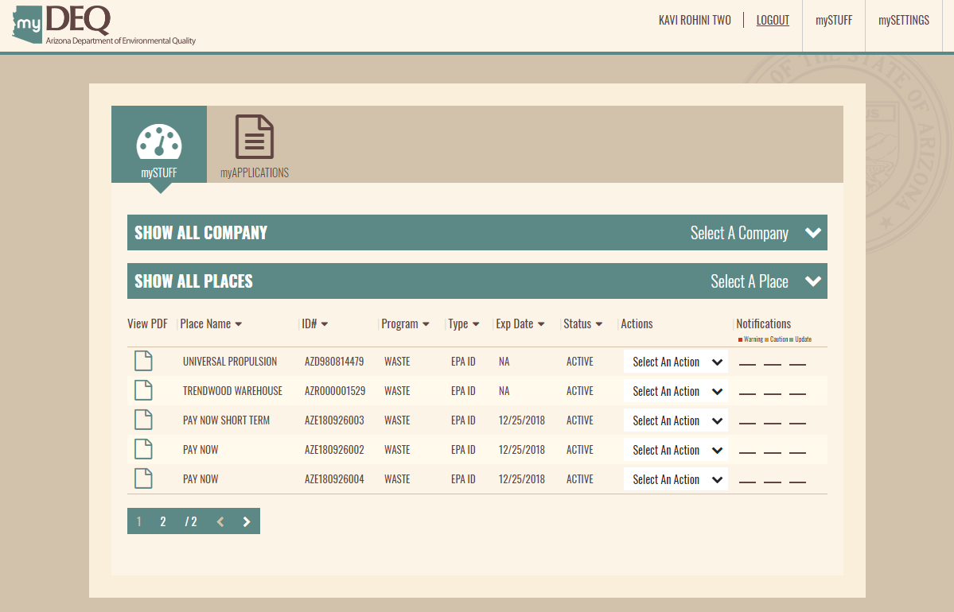
myDEQ
Notification Process
Notes:
Once you are registered you can navigate to your dashboard, known as myStuff.
Here you can see all the places that can be managed by the user.
You can also choose to see all the companies for which the user can manage sites.
I though I would show you a little of how to apply for a new EPA ID number, so the first step is to click on my applications.

Slide 11
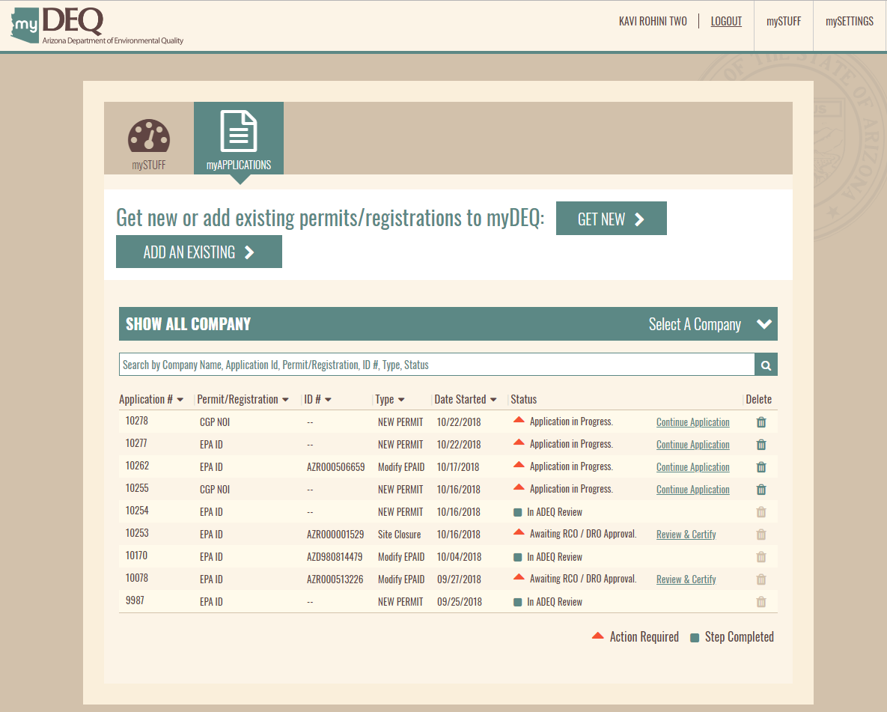
myDEQ
Notification Process
Notes:
This will take you to the a page showing every permit etc applied for.
But we want to get a new EPA ID number, so clidk on the Get New button.

Slide 12
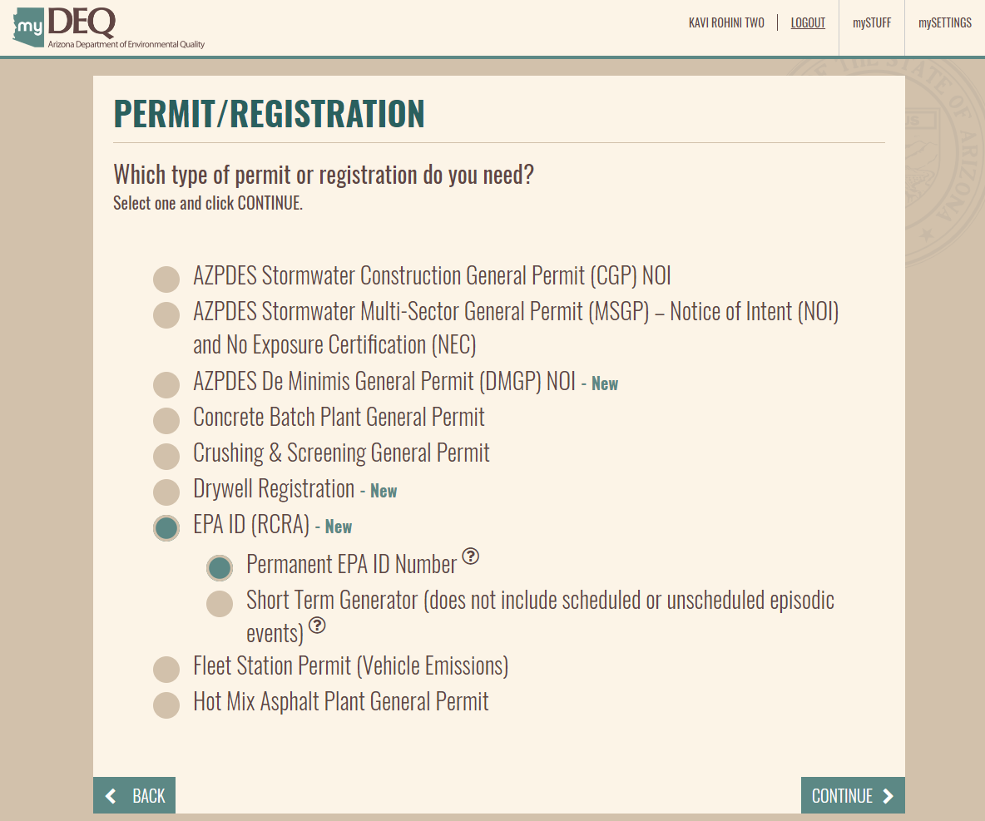
myDEQ
Notification Process
Notes:
This takes you to a page that shows all the permits and registrations currently available on-line.
If you click on EPA ID (RCRA) it will reveal two type of EPA ID numbers, Permanent and Short term.
Most should click on permanent as short term is for one-time events, and if you have episodic events that occur occasionally, you should get a permanent number at a low generation status and take advantage of the episodic option when the events are about to occur. Its cheaper that way.
Click EPA ID and then Permanent. Move to the next page by clicking continue.
At anytime, you can click on back and the app will take you back to the previous logical step.

Slide 13
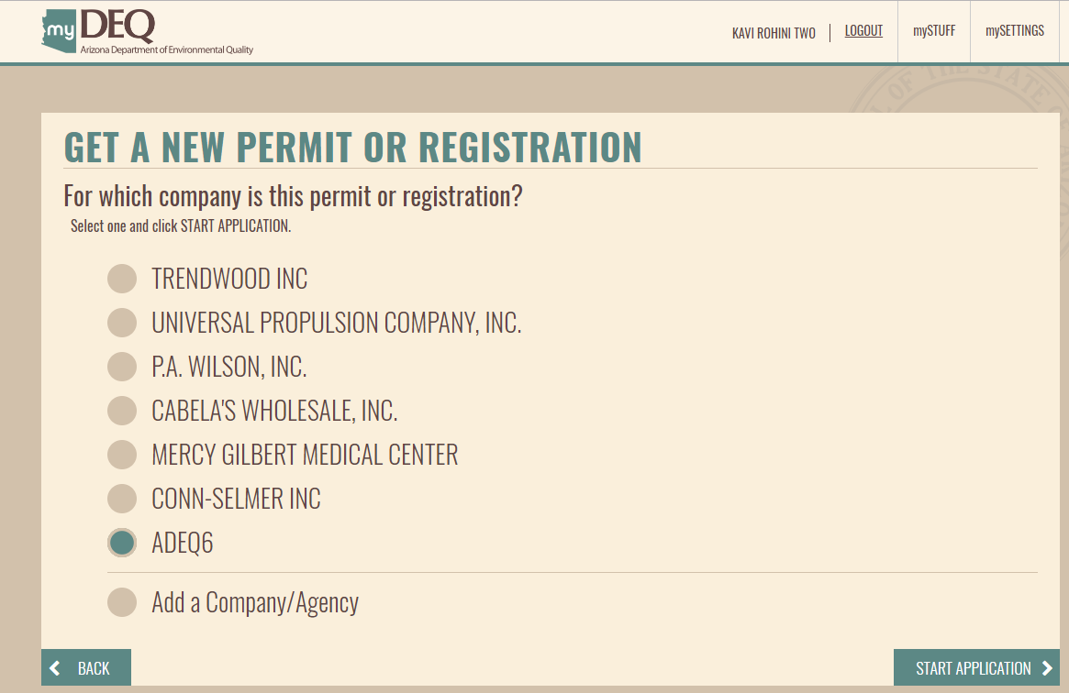
myDEQ
Notification Process
Notes:
A new screen appears showing all the organizations that you are managing.
Choose one by clicking on it and then click on start application.

Slide 14
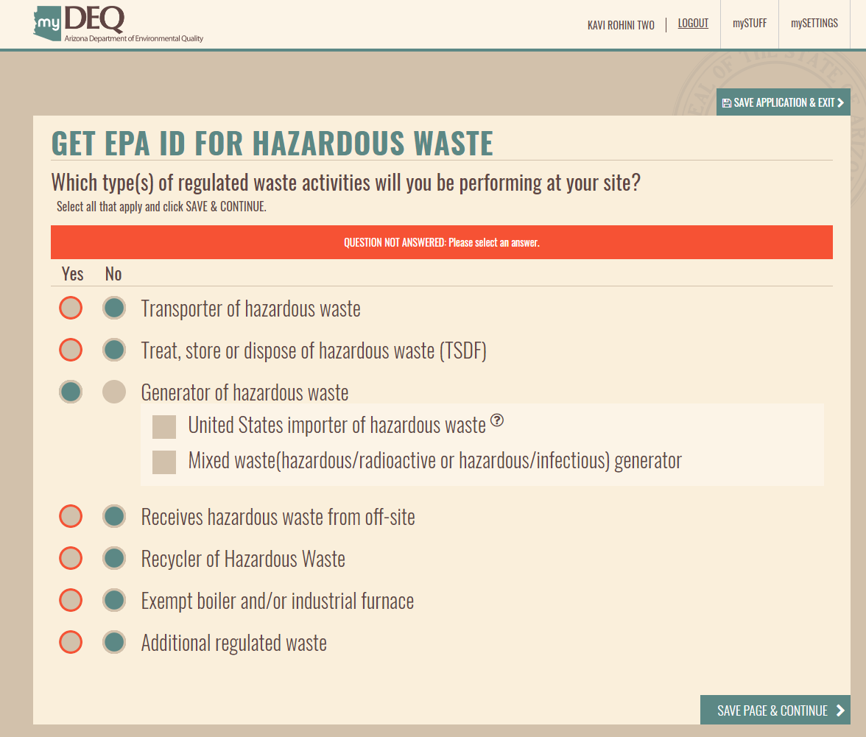
myDEQ
Notification Process
Notes:
Now we’re into it. Check the type of hazardous waste activity that will be occurring on the site.
You need to answer yes or no to each question, otherwise a pop-up will appear telling you that you have not answered everything.
I have selected only a generator of hazardous waste.
Once you click on save page and continue, you will move on to the next screen and everything you have completed up to this time will be saved and appear on your dashboard. The app only gives you 20 minutes to complete the transaction, but don’t panic if it closes on you as it is saving as you go.
If you want to stop the process to dig up information that you might need,, you can click Save Application and Exit. You can come back to the process later.
When you click save page and continue a pop-up appears stating the type of handler you are applying to be, so that you can verify that it is correct.
Click on continue.

Slide 15
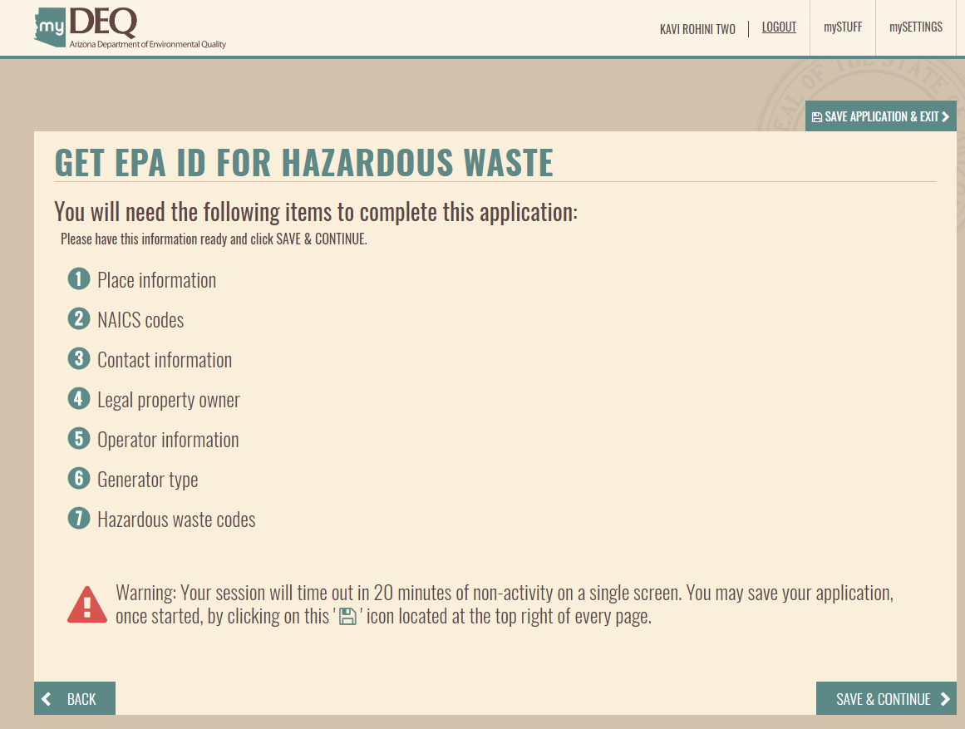
myDEQ
Notification Process
Notes:
Next the app shows you a page that alerts you to what information you should have at your disposal to complete the application process. It also, warns you that if you spend more that 20 minutes on a screen, it will log you out.
Click save and continue.

Slide 16
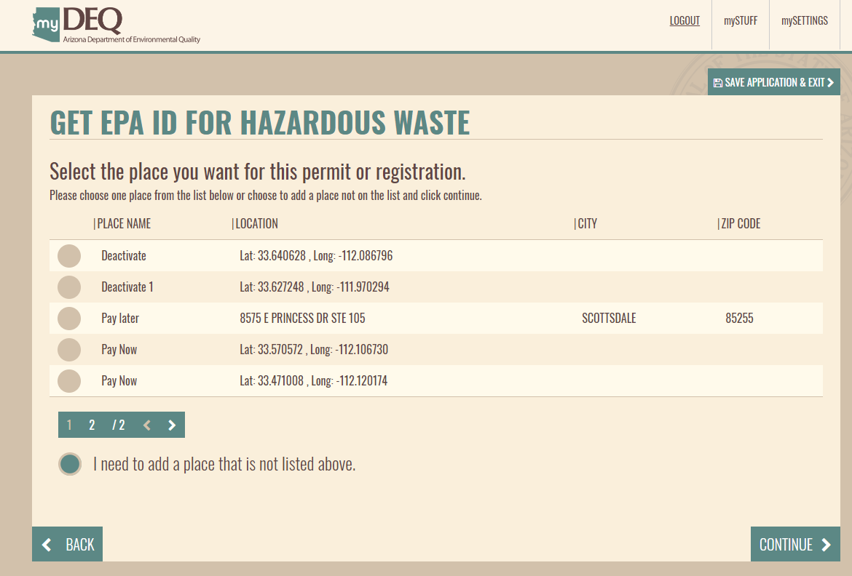
myDEQ
Notification Process
Notes:
If you already have sites on your dashboard the app will display them to you and ask if you are applying for a EPA ID number for any of the present sites.
If so, select it and click continue.
We are added a new site, so click on I need to add a place that is not listed above, and click continue.

Slide 17
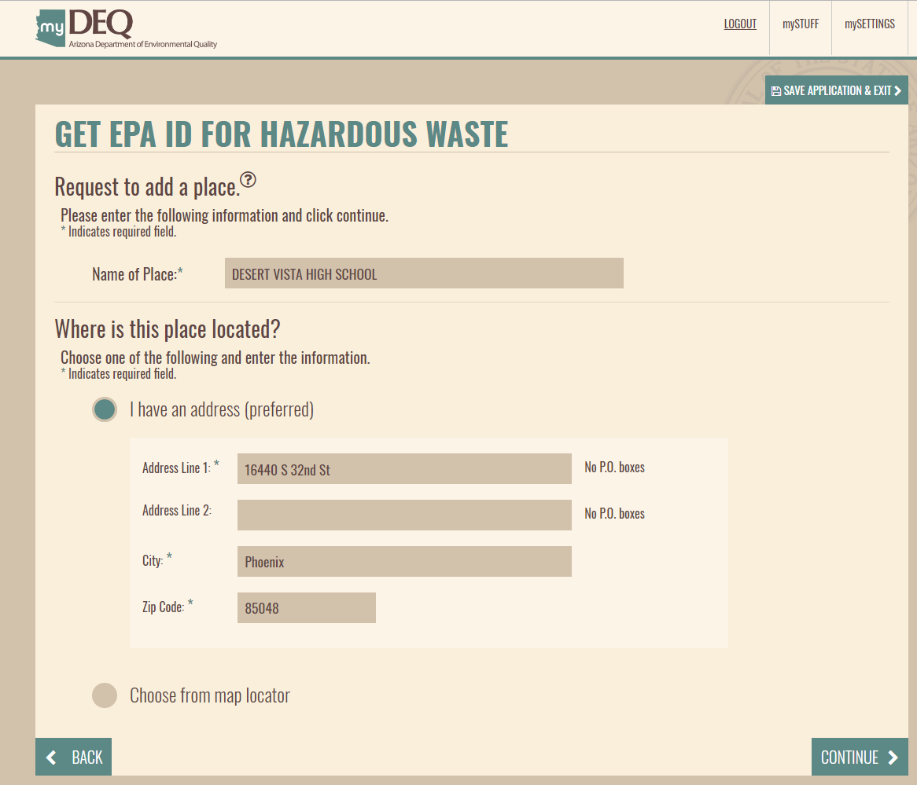
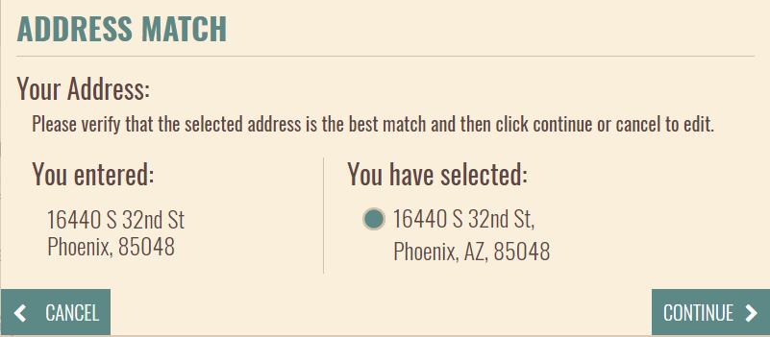
myDEQ
Notification Process
Notes:
You are now on one of the more important screens to see.
Here you create the “place” or location of where your site is.
Enter the name of the site and the address.
You can also choose to locate the site by using a map. In this case, we will use the address option.
When you click continue, a pop-up appears that matches the address you entered with an address determined by Clean Address, which makes sure that the address exists and it is in the correct format.
Click the verification button and continue.

Slide 18
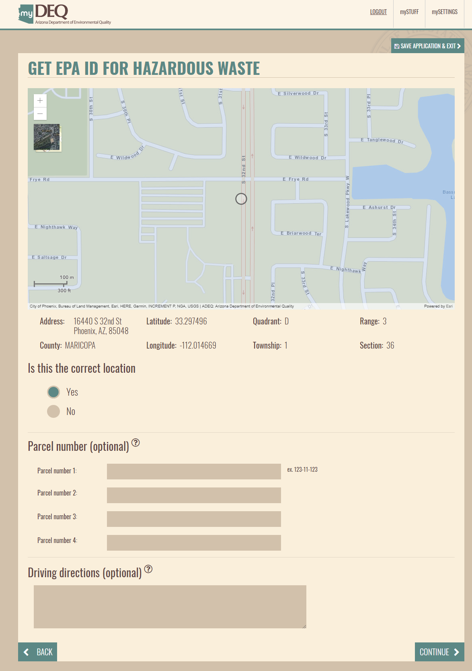
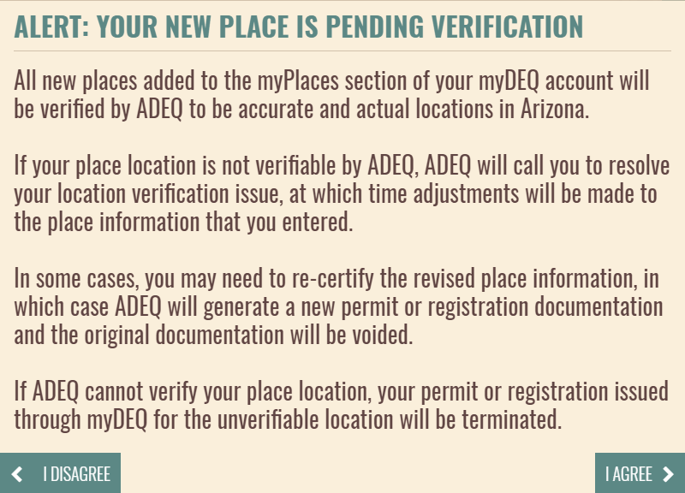
myDEQ
Notification Process
Notes:
myDEQ will map your site, so you can make sure it is where you intend it to be.
It will also give you the latitude and longitude along with the Township and range.
You can agree or discard the site chosen.
If your site has one than one parcel, you can add parcels on this page.
And if you chose to use the map first without using an address and the site was in a rural area without an address, you can add driving directions to substitute for it.
Click on Yes this is the correct location and continue.
A pop-up appears stating that ADEQ will be verifying all new places and if it cannot verify it, the application will be terminated.
Click I agree.

Slide 19
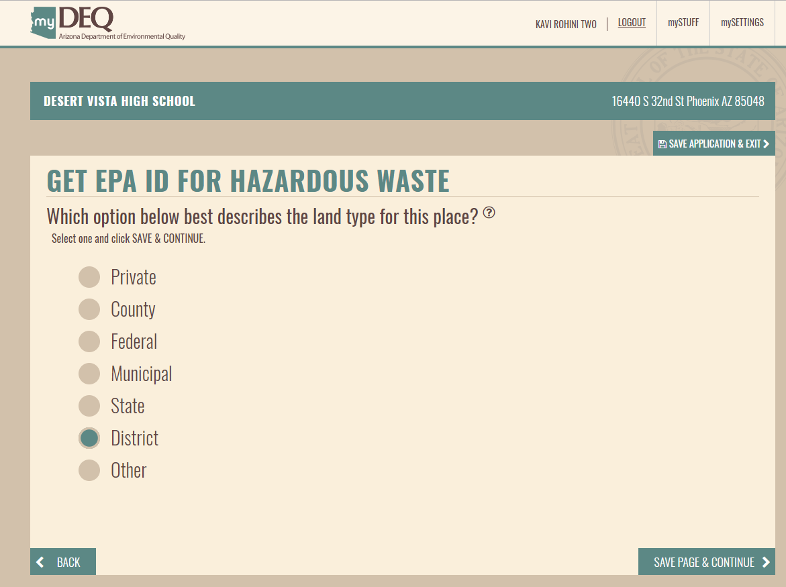
myDEQ
Generation and Registration Reporting
Notes:
Choose the type of place and click the save and continue button.

Slide 20
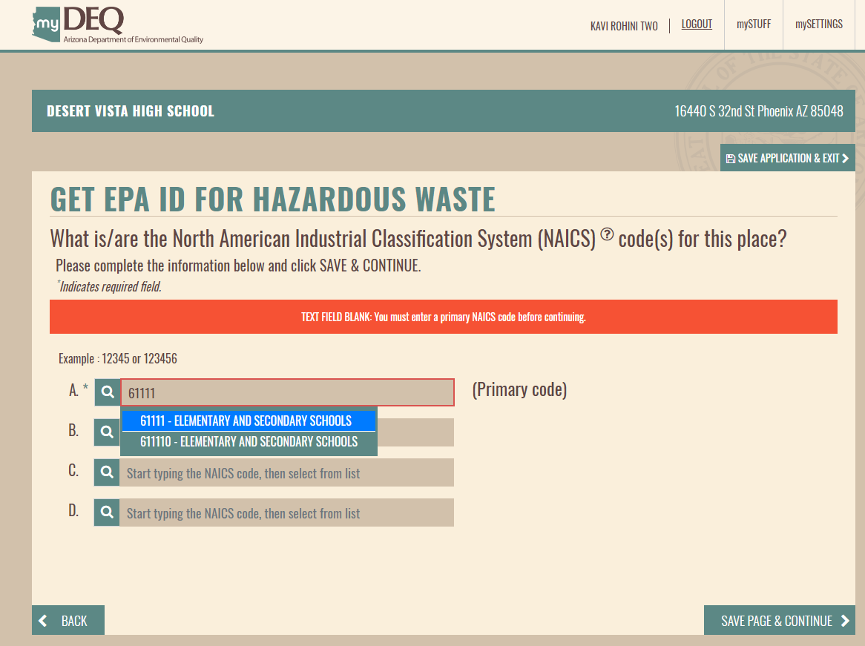
myDEQ
Notification Process
Notes:
Enter your NAICS code. If you are not sure what it is you can click on the magnifying glass to start looking.
Once you start entering you code, suggestions will auto-populate and you can click on the one that best describes the business activing occurring on the site.
You need to enter at least one NAICS code, but you can enter up to four.
Click Save and continue.

Slide 21
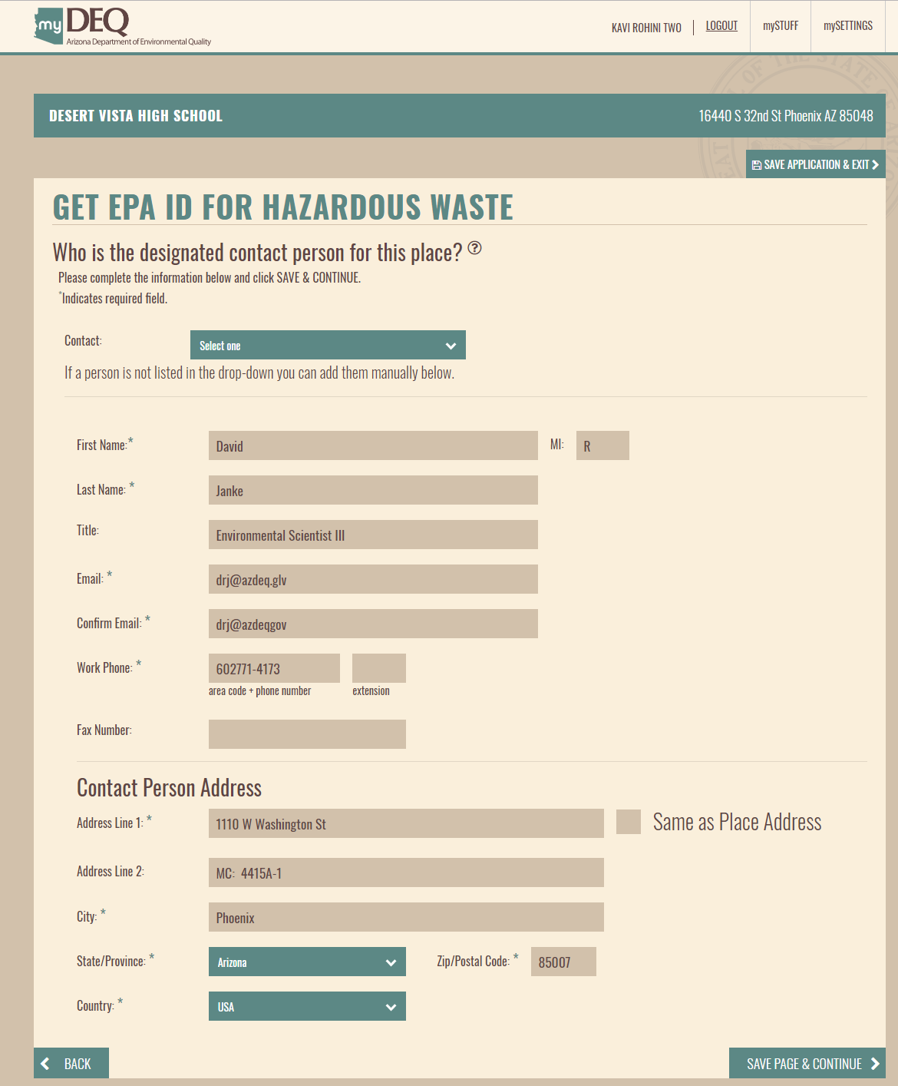
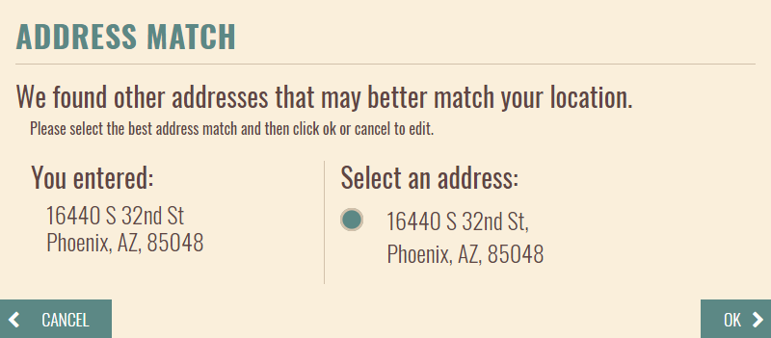
myDEQ
Notification Process
Notes:
The next page is where you enter the sites primary contact’s name and contact information. I would suggest that this be either the DRO or the RCO, as this is the email address to which all correspondence will be directed.
Therefore, the person needs to be familiar with the activity on the site, but also should be able to certify and submit any documents.
When you click on the save and continue button, the address match pop-up will appear again.
Click that you agree with the address and ok.

Slide 22
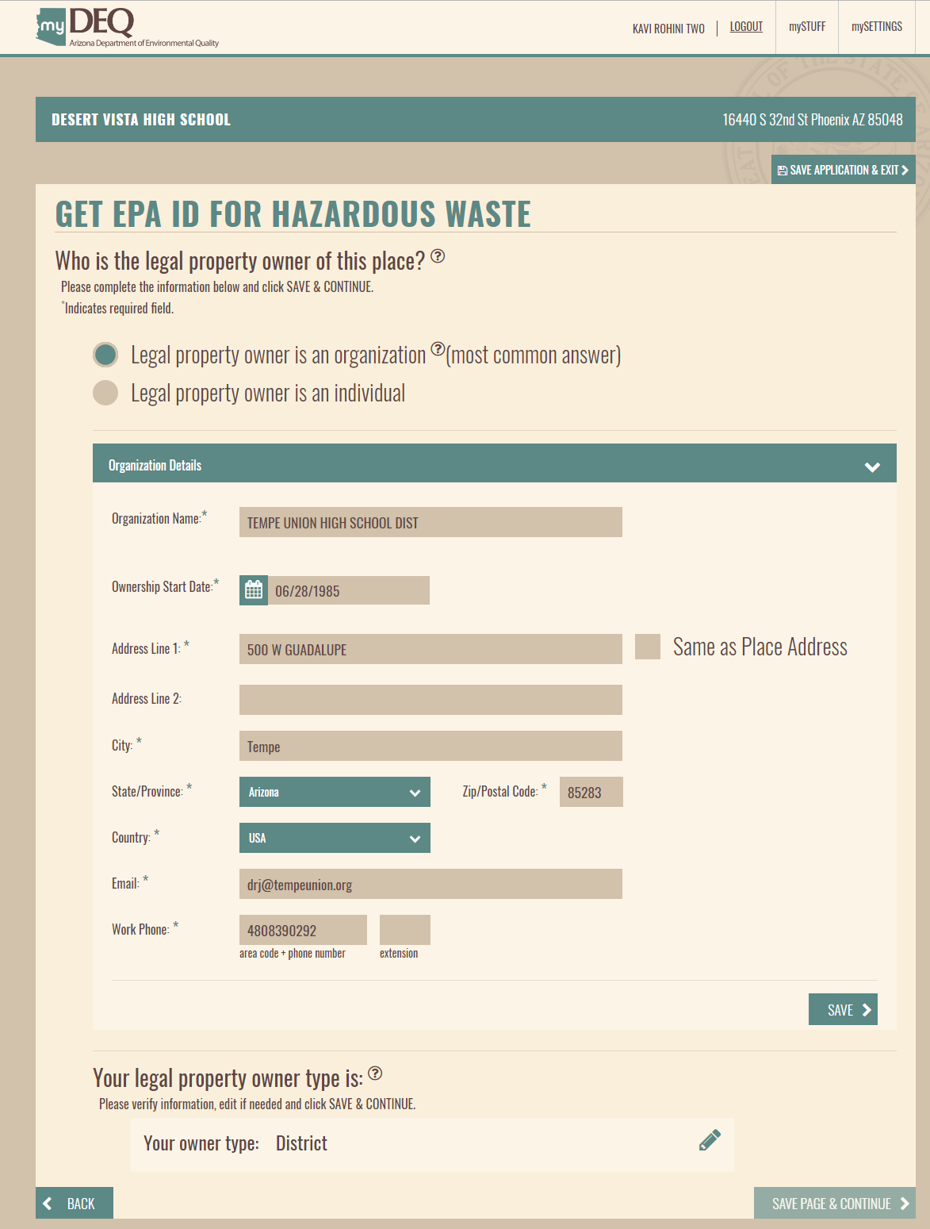
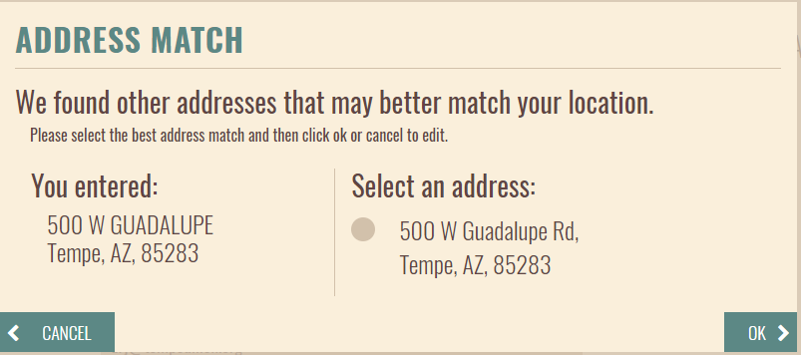
myDEQ
Notification Process
Notes:
This is the page to which you will need to pay the most attention. It is the owner page.
The owner is the owner of the property and not the owner of the business.
Think of it this way.
The primary contact is the contact person. This is the person ADEQ will call or email 99 percent of the time.
The operator, of the business is the second mode of contact in case the contact person is out of has left the job.
The owner is the contact if the contact person has left and so has the business. The owner of the property doesn’t move until the property is sold.
Therefore, the owner should be the organization of person(s) listed by the county assessor’s office as the owner of the property.
The address of the owner should be the address in the assessor’s office, unless you have a more up-to-date address.
The ownership start date is the date on the deed or the date on which the deed was recorded.
After entering the appropriate information and clicking the save and continue button, the clean address pop-up appears again.
Verify the correct address and click ok.

Slide 23
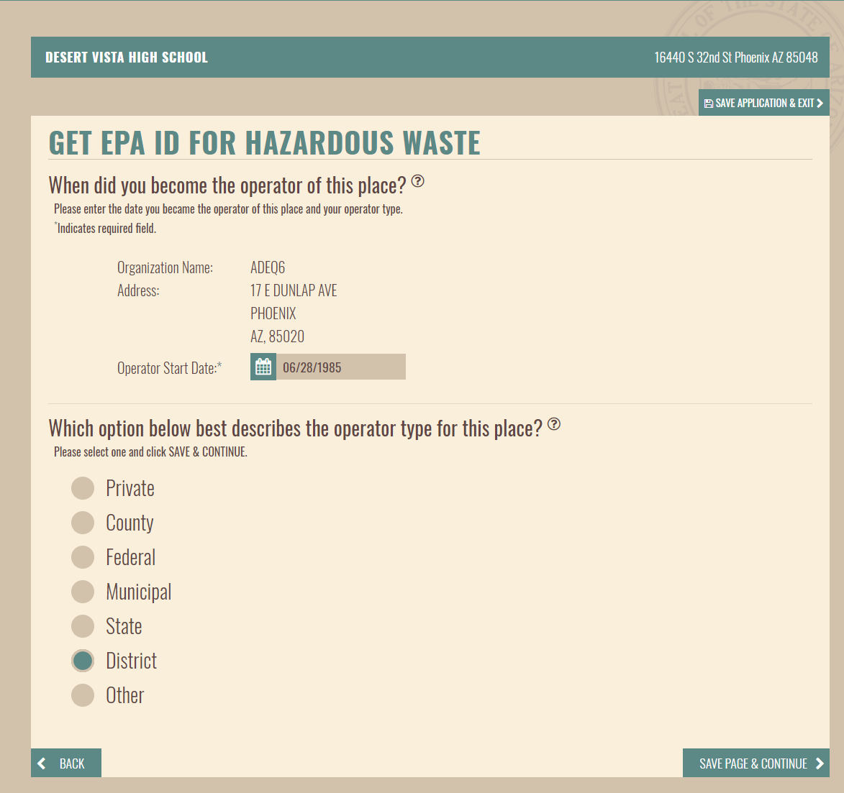
myDEQ
Notification Process
Notes:
On this page you complete the information needed for the operator, which is the organization operating the business on the site. It is the organization for which you registered.
Enter the date became operator, the type of organization and click save and continue.

Slide 24
myDEQ
Notification Process
Notes:
Now we get to the questions that you will also see if you are modifying an EPA ID number.
This page is for the site’s generator status.
Set the status and click save and continue.

Slide 25
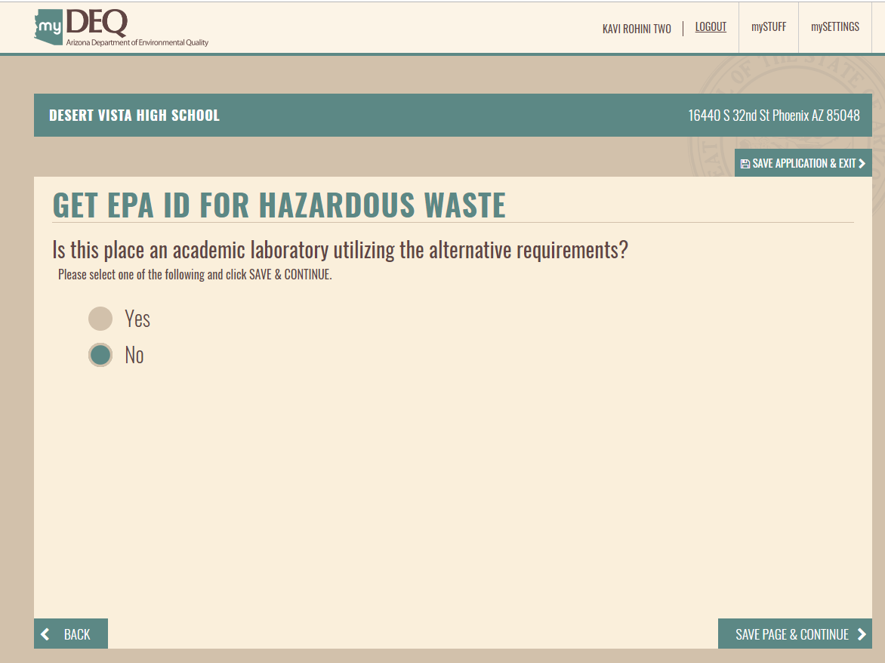
myDEQ
Notification Process
Notes:
This is the academic laboratory page.
Not too many institutions have answered yes to this question. I don’t believe that even U of A, A S U nor NAU have answered yes to this.
If you are an academic institution and think you may qualify, I would read the regulations thoroughly.
Check the no box and click Save page and continue.

Slide 26
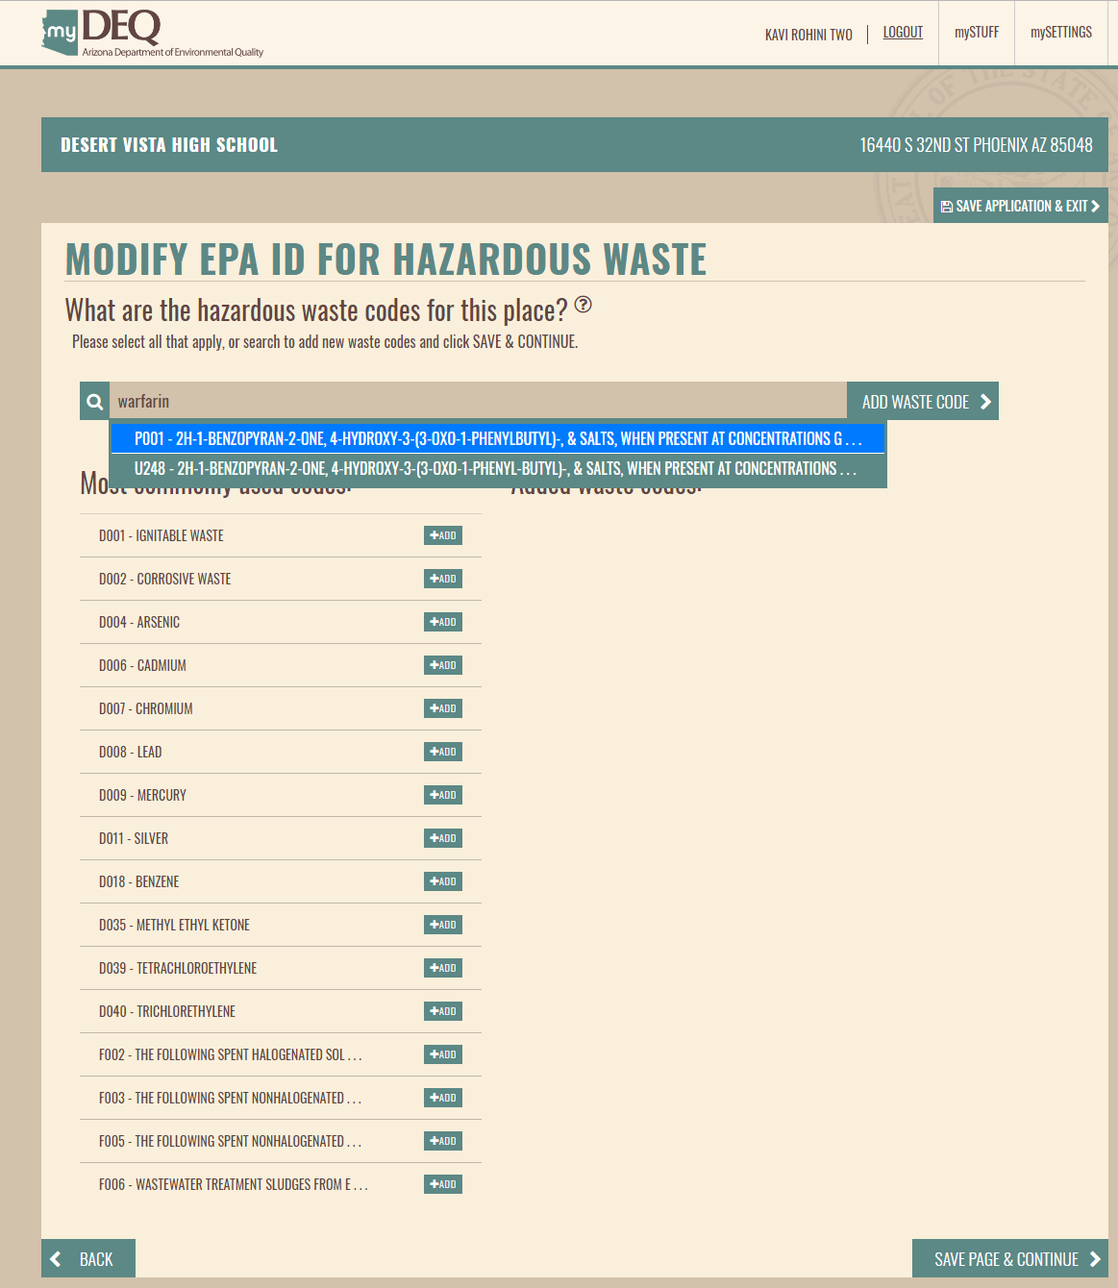
myDEQ
Notification Process
Notes:
Here is the waste codes screen.
You can type a waste code into the upper field. You can even enter a waste name and the app will give you suggestions to choose from.
In this case I tried to fool the program by using warfarin, but it did return the correct suggestions, P001 if the concentrations are above the limit to make the waste acute, and U248 if below the acute concentration.
If you click on the highlighted suggestion it will fill the waste code field. If you then, click the add waste code button it will appear on the right below this field, where all selected waste codes appear before you hit save.

Slide 27
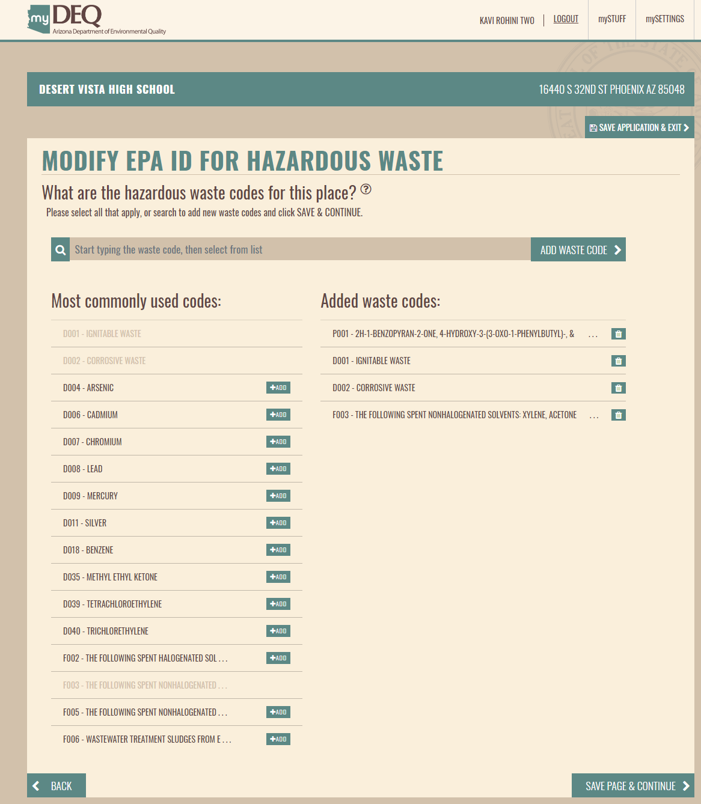
myDEQ
Notification Process
Notes:
You can see that P001 now appears on the right of the screen.
On the left is a list of the most commonly used waste code. You can add these to your site by clicking the add button and they too will move to the right of the screen.
When you are finished click save page and continue.

Slide 28
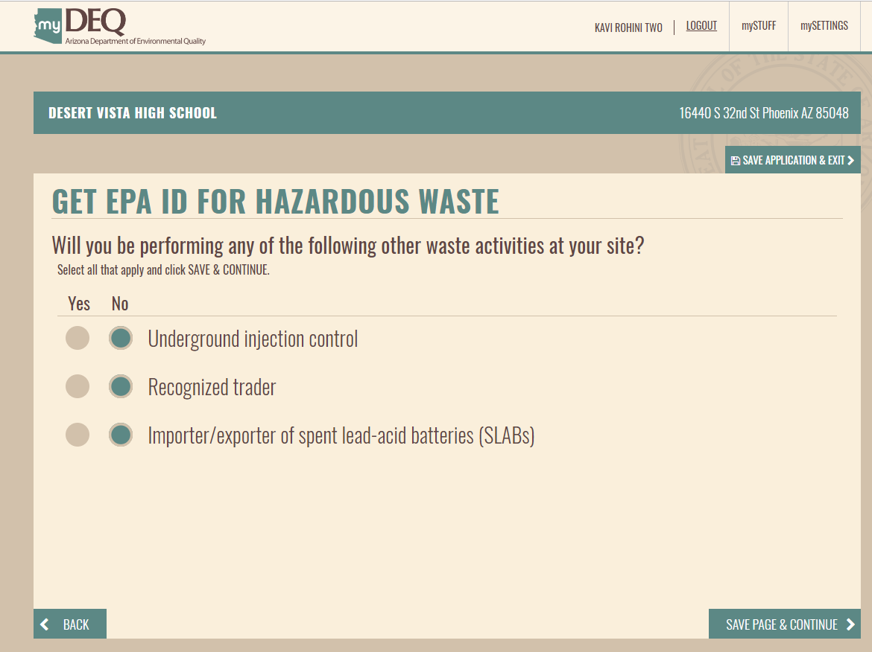
myDEQ
Notification Process
Notes:
Once you pass the waste codes page the next five pages are devoted to very specific hazardous waste handling functions. Those who perform these functions will be looking for these answers. Most generators should answer no to all the questions
This page is for Underground injection control, recognized trader and importer/exporter of spent lead-acid batteries.
Answer no and hit save a continue.

Slide 29
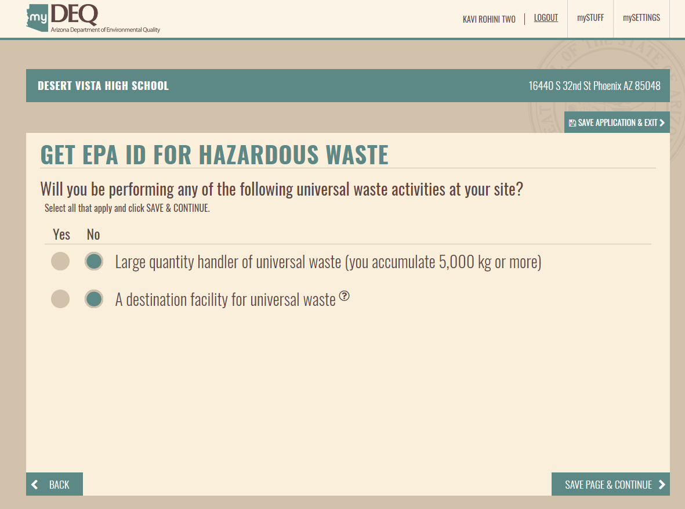
myDEQ
Notification Process
Notes:
This screen is for universal waste.

Slide 30
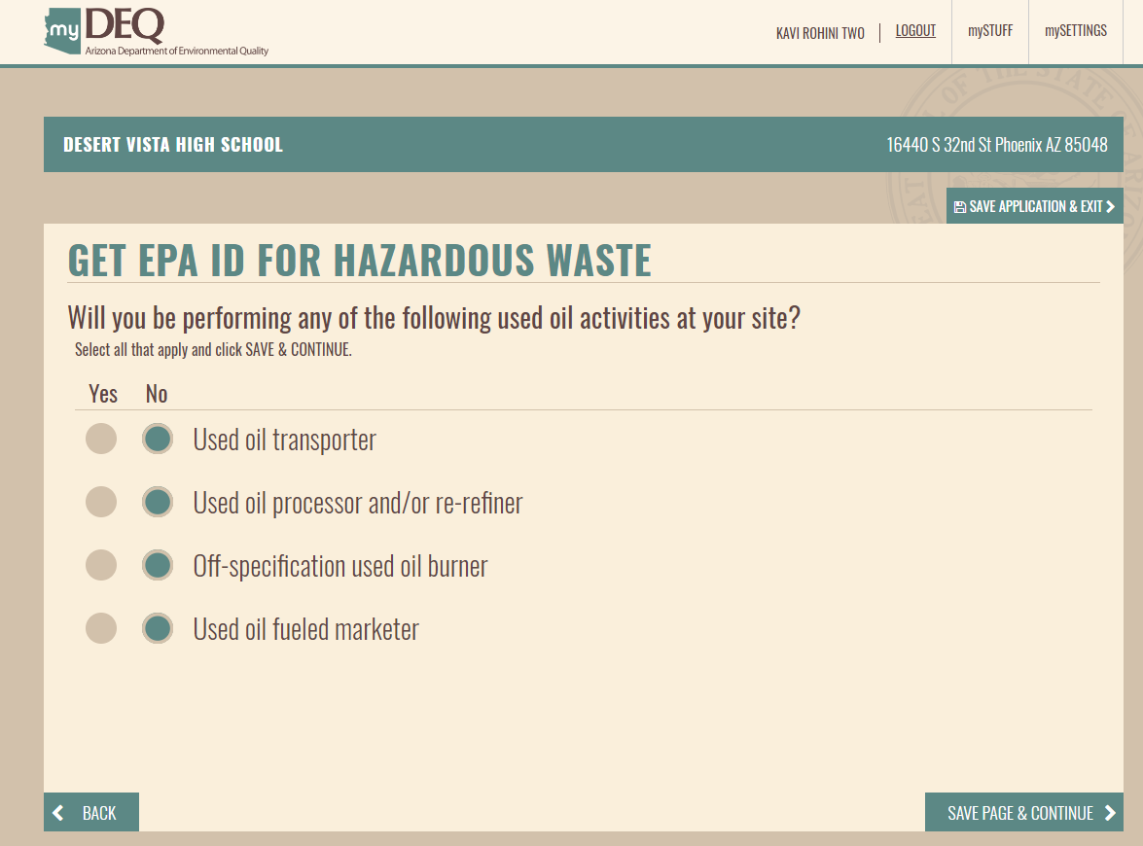
myDEQ
Notification Process
Notes:
This screen is for used oil activities.

Slide 31
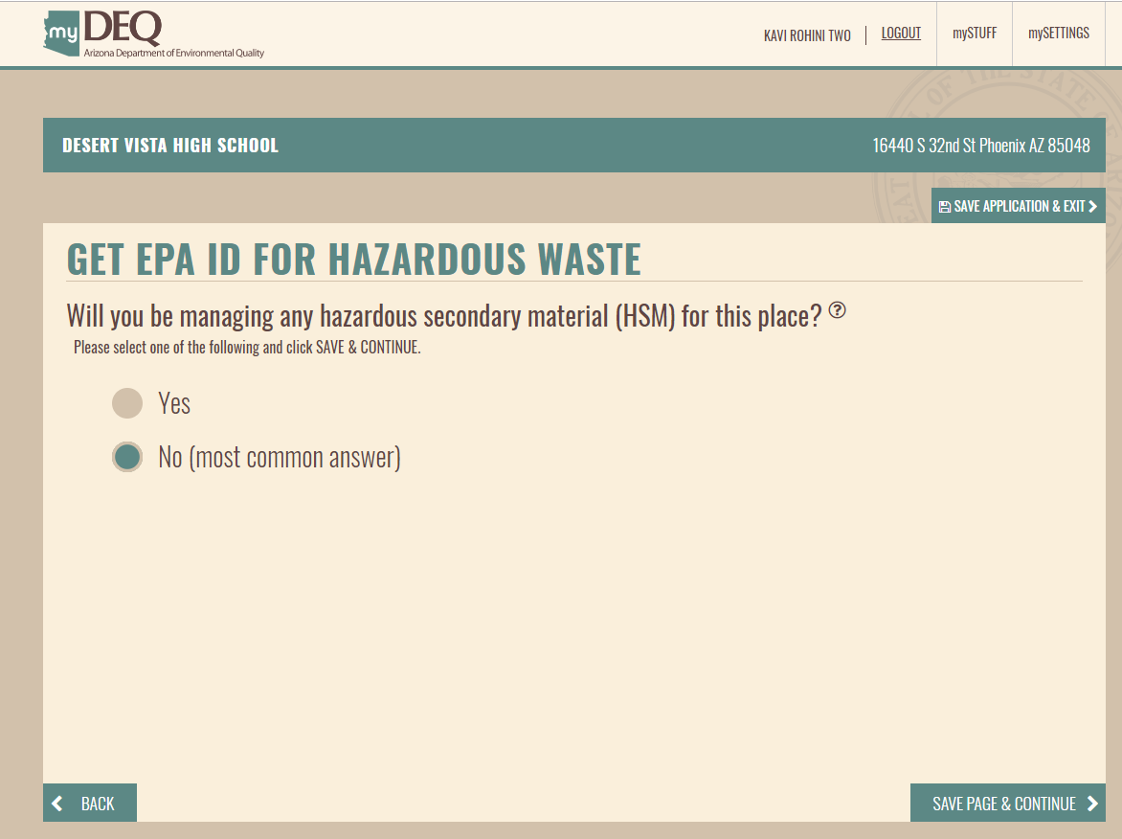
myDEQ
Notification Process
Notes:
This screen is for hazardous secondary material.

Slide 32
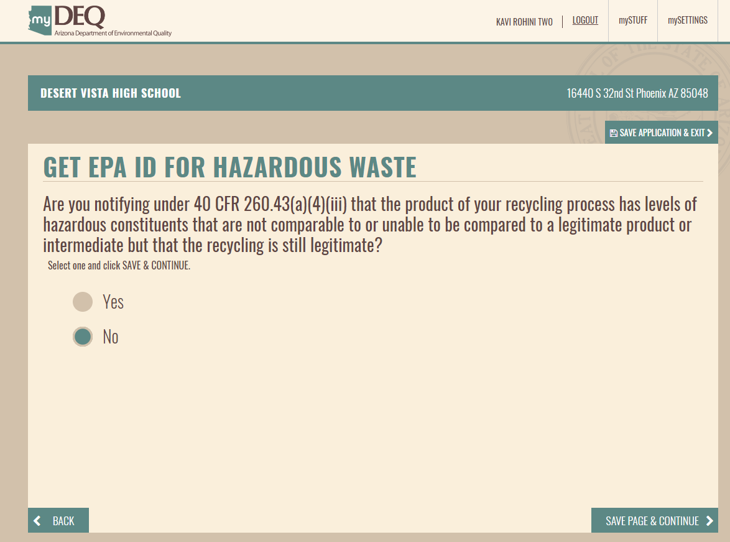
myDEQ
Notification Process
Notes:
This screen is for on-site recycling processes.

Slide 33
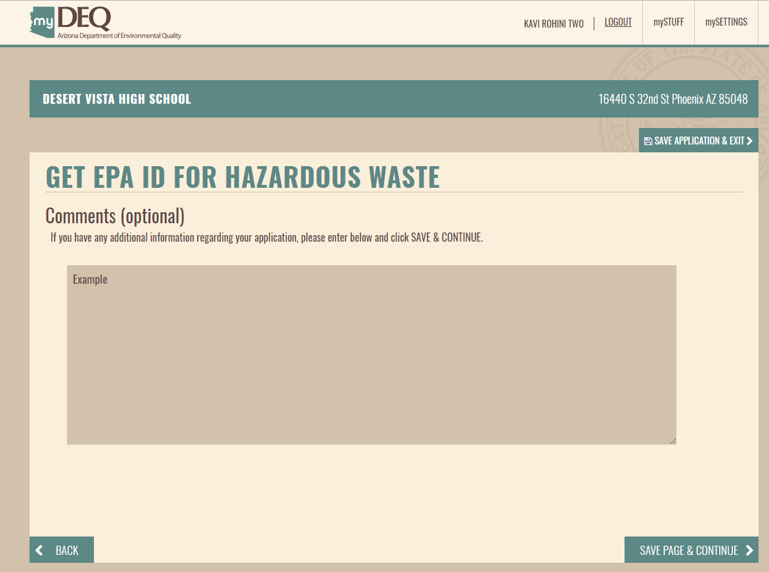
myDEQ
Notification Process
Notes:
After all the handling specific questions, you arrive at the comments page. Here you can enter any additional information you believe is necessary to understanding the activities occurring on the site.
Comments are required if you are applying for a one time event. If you are and you try to save page and continue, the app will let you know that you need to enter an explanation.
Click save page and continue.

Slide 34
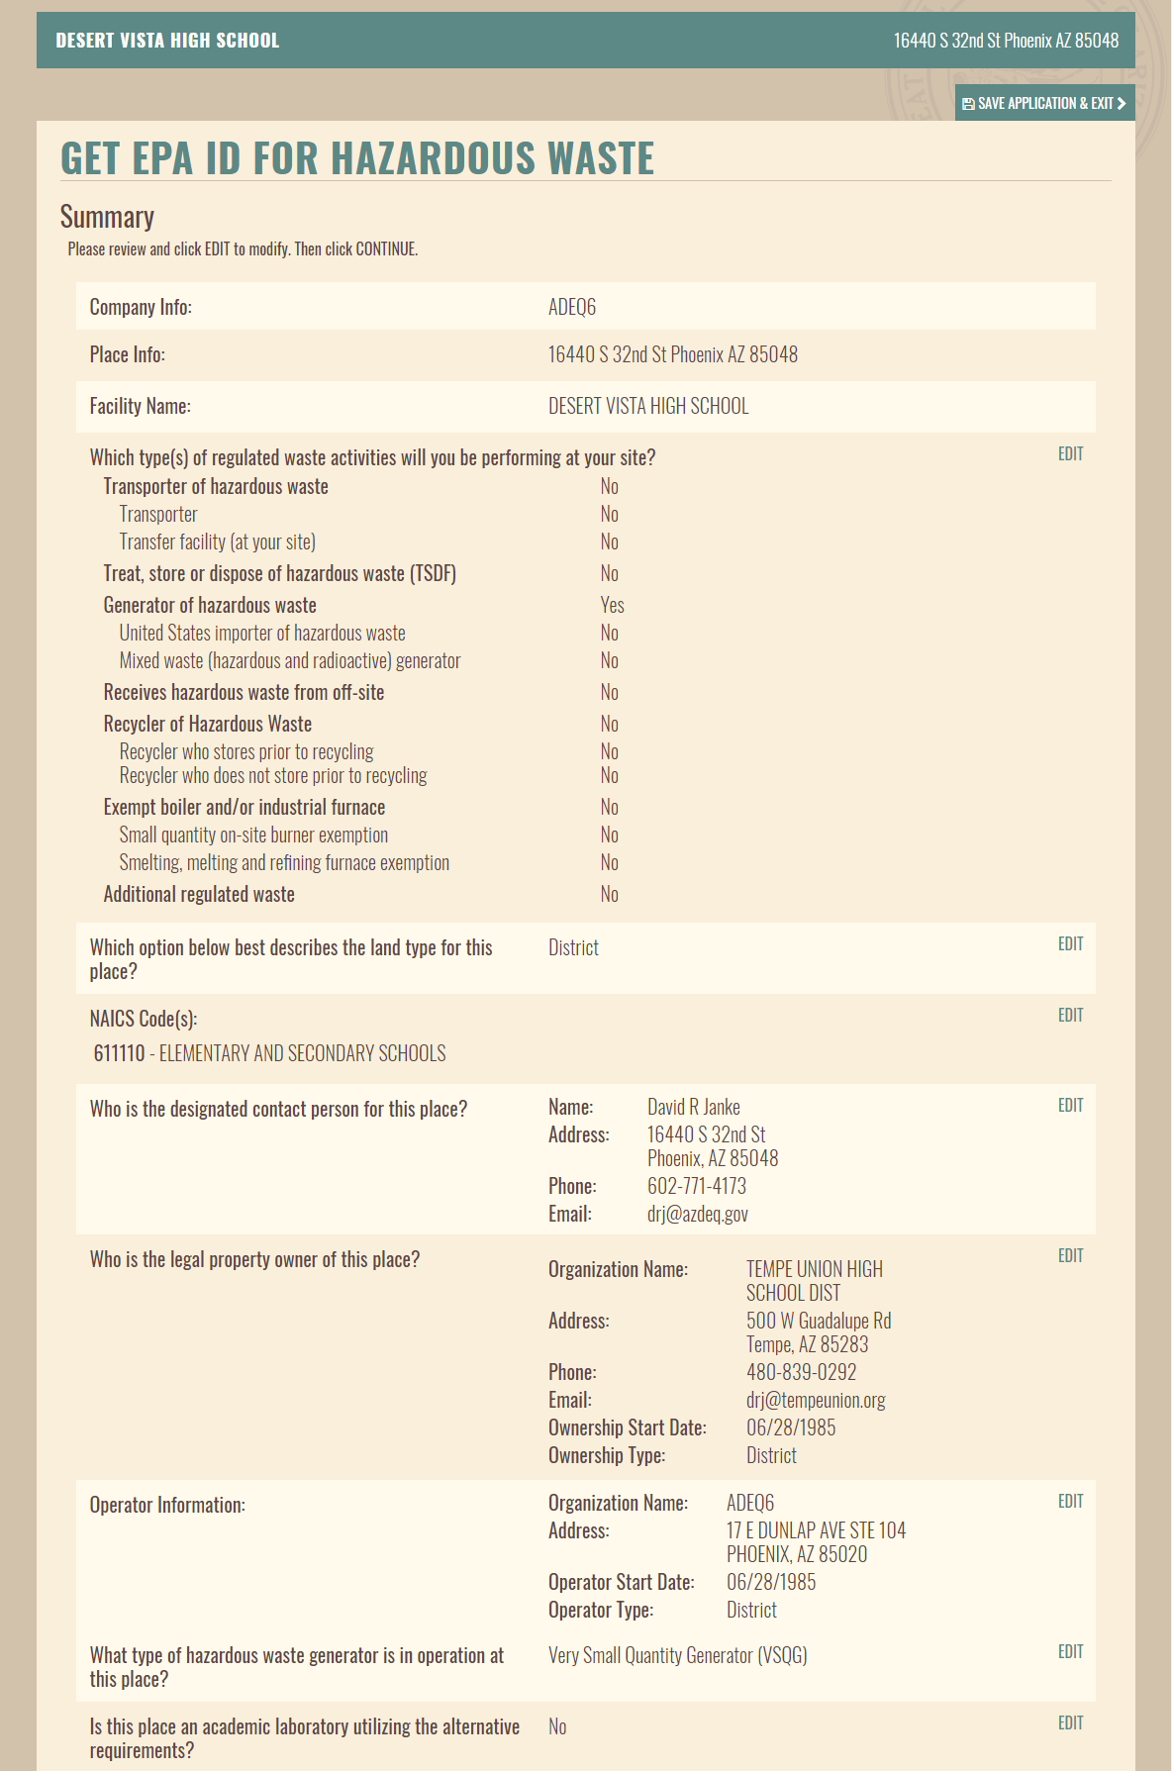
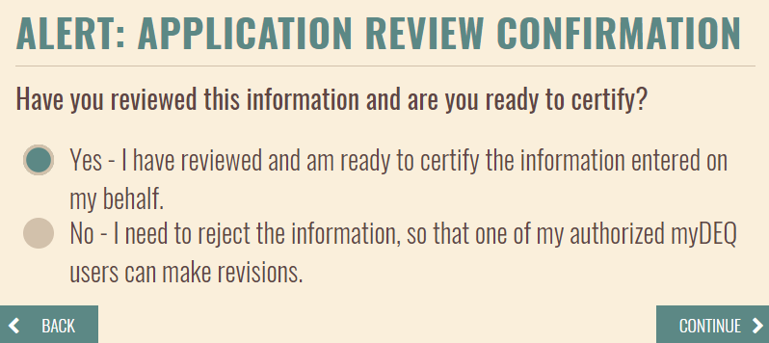
myDEQ
Notification Process
Notes:
Your application is almost complete. The only item left is to certify that all your answers are correct.
The app gives you a chance to review all your answers. If you need to change an answer, click the edit button and the app will return you to that page.
If everything is correct and you click the save page and continue button, a pop-up appears making sure that you have double checked your answers.
If you are happy, check yes and click continue.

Slide 35
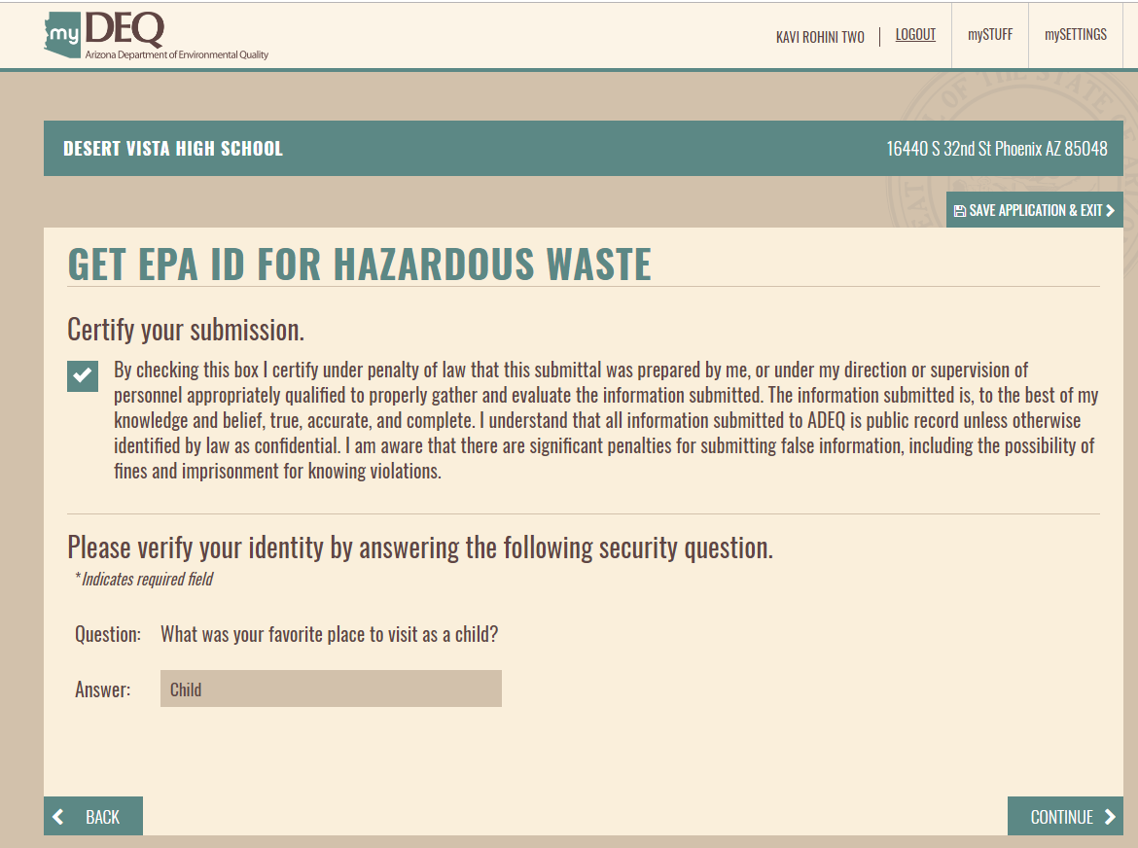
myDEQ
Notification Process
Notes:
This is the certification page. You should read the statement on the page and if you are ok with the statement, check the box and answer one of the personal questions you chose when you registered as an RCO or DRO.
Then click continue.

Slide 36
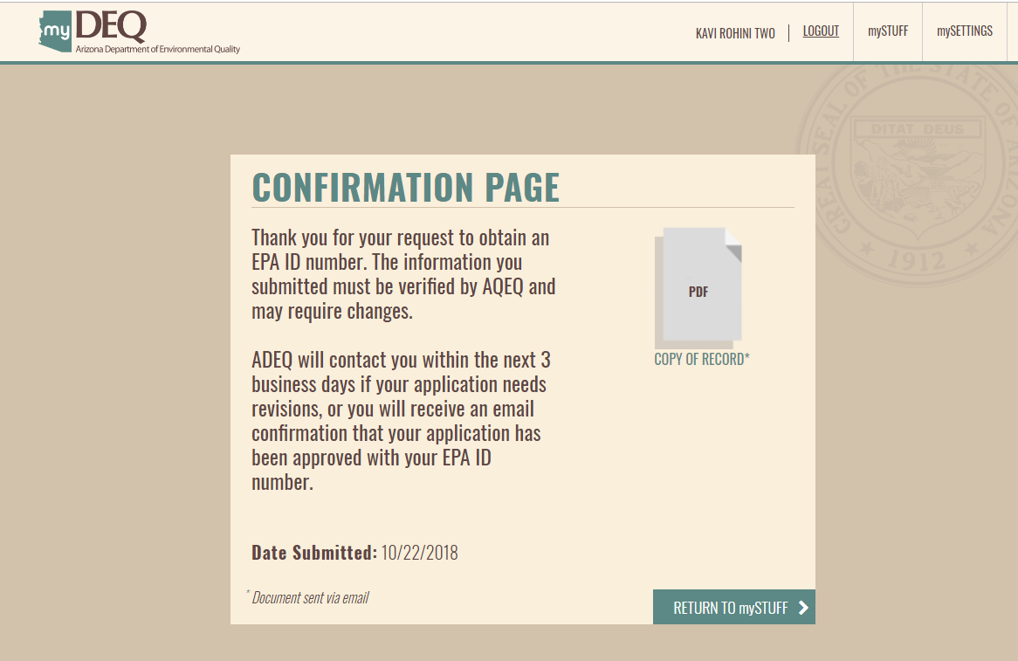
myDEQ
Notification Process
Notes:
Once you have certified you will see the confirmation page. You can print a copy of record by clicking on and opening the PDF that is show on the page.
You can return to the mySTUFF screen if you have other business for you can log-out.

Slide 37
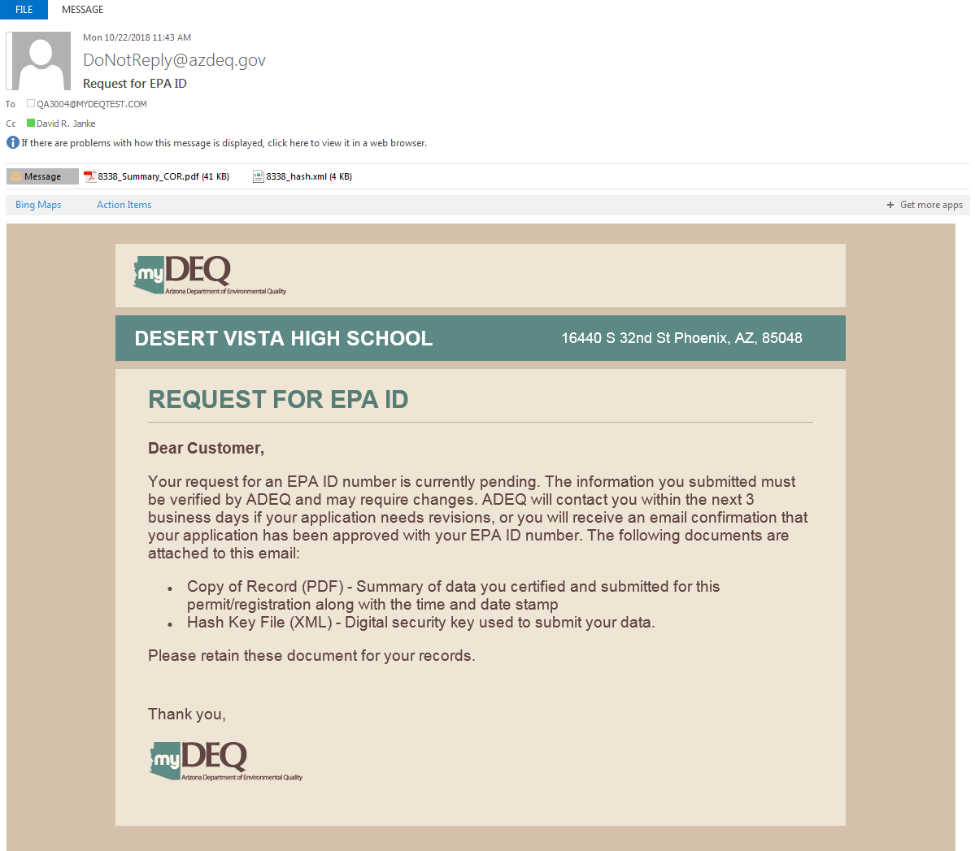
myDEQ
Notification Process
Notes:
MyDEQ will also send you an email documenting that notification has been received.
Before issuing an EPA ID number ADEQ staff will verify specific portions of the application to ensure they are correct.
These include the site location, whether it is correct and whether a record and even an EPA ID number already exist for that location.
And the owner information, to make sure it agrees with what can be found on the county assessor’s office website.
So, you may be asked in another email to revise the application.

Slide 38
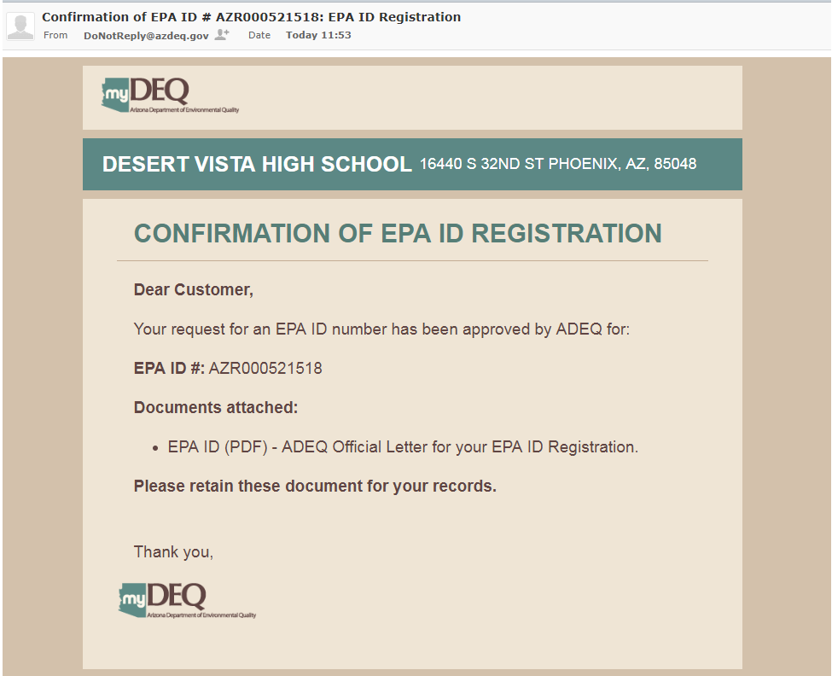
myDEQ
Notification Process
Notes:
Once all the information has been verified as correct you will receive an email containing the EPA ID number. The email has an attachment which is the office letter documenting the EPA ID number for the site.
Print and keep this letter in your files.
And the process is complete.

Slide 39
myDEQ
Generation and Registration Reporting
Notes:
When it is time to report hazardous waste generation quantities and/or submit your annual hazardous waste registration, myDEQ will forward an email to you letting you know that it is time to complete these reports.
The reports are similar, therefore, I though I would show you a small video on how to report your generation quantities.
(Video to be supplied by communications)

Slide 40
E-Manifests
Benefits
Option to create and submit manifests electronically
Cost savings and paperwork burden reductions
Accurate more timely information on waste shipments
Creation of a single hub for reporting of manifests data
More effective compliance monitoring by regulators
Potential to integrate with RCRA’s biennial report and state systems
Enhanced “cradle to grave” tracking of HW
Notes:
So, lets go over the benefits which EPA believes e-manifests will deliver.
First, the app will give you the option to create and submit manifests electronically. It is not required by EPA that you use electronic manifests. Paper is still an option as are other types of forms. We will go over the options, and who ultimately will determine the option you will be using later in the webinar.***
There will be cost savings and definitely paperwork burden reductions. The whole idea of e-manifests is to go paperless, so there should be no more copying, filing and mailing of manifests. That will reduce time and money. However, EPA will be charging a fee for each manifest created or entered into the system. I will go over the fees coming up.***
Manifest data will be more accurate and timely. As e-manifests are created in the app, once submit is hit, the data is saved. As there will be no third party entering in data from paper, there will be fewer mistakes made due to typos or hard to read copies.***
There will be a single hub for reporting of manifests data. Now each state is responsible for tracking manifest data. That is 50 plus systems. With e-manifests there will be only one. That will make requesting data for a handler doing business in several states much easier.***
Since the data will be housed in a single database, and the data will be available dynamically, compliance monitoring will be easier and more effective.***
Here is a big one, at least for me as I deal with this each year for ADEQ, the system will be able to integrate with EPA’s biennial report system. That means if you are an LQG and are required to complete an annual or biennial report, your data will already be available to you in the RCRAInfo database, which will house EPA ID number data, manifests data and biennial report data. ***
All this will lead to enhance cradle to grave tracking of hazardous waste.***

Slide 41
E-Manifests
Top Five Things
1. e-Manifests launched on June 30, 2018
2. The testing environment is still available
https://rcrainfopreprod.epa.gov/rcrainfo/action/secured/login
Notes:
Here are the top 5 things you need to know.
#1. Most importantly, e-Manifests will launch on June 30, 2018. This will happen nation-wide, every state at the same time. No exceptions.
#2. Though the app is not live at this time, you can sign up, browse, test and comment on the preproduction version of the app by going to
https://rcrainfoprepro.epa.gov/rcrainfo/action/secured/login
This will help you, not only become familiar with e-manifests, but you can become familiar with how to register for the app when it goes live.
After all, I find that the hardest part of using software is logging in.

Slide 42
E-Manifests
Top Five Things
3. Receiving facilities must submit manifests to EPA
RCRA hazardous waste and/or state only hazardous waste
TSDFs and RRFs and facilities that receive state only hazard waste
Electronically or paper (all or nothing)
To submit electronically each facility must register for E-manifest
User Fee rule set fees charged to receiving facilities
Electronic submission (includes hybrid manifest) $5
Data file uploads $6.50
Image uploads (scanned copies) $10
Mailed paper $15
Notes:
#3. Here is the big one.
Receiving facilities are responsible for submitting each and every manifest to the EPA.
Receiving facilities include sites that receive both RCRA hazardous waste and/or state only hazardous waste. It may also include sites receiving PCB waste.
In Arizona this includes treatment storage and disposal facilities that receive state only hazardous waste. As Arizona has no state only waste, this would apply to sites receiving state only waste from other states such as California and Texas.
ADEQ is particularly interested in making sure these sites sign up of the program.
The receiving facility may choose to submit electronically or by paper. However, it is an all or nothing deal. If electronic, all manifests need to be submitted electronically. If paper, all manifests must be submitted as paper. Therefore, if you are a generator or transporter, you will need to coordinate with your receiving facility to determine if you need to register for e-manifests or not.
If submitting electronically, each receiving facility must register for e-manifests.
The receiving facilities are also responsible for paying the fee associated with each manifests. These fees may affect the cost for each generator, so please take note. Here is the breakdown of fees:
Electronic submissions – which includes hybrid manifests is $5
If the receiving facility has its own electronic manifest system and uploads the manifests from it then the cost is $6.50
It is $10 if paper manifests are used and then they are scanned and emailed to EPA.
Finally, if the paper manifests are sent to EPA by regular mail, then the cost is $15 per manifest.

Slide 43
E-Manifests
Top Five Things
4. A Handler should register for e-Manifests if:
Initiate/create an e-manifest
Submit an e-manifest to EPA
Make corrections to an e-manifest
Track its waste through the e-manifest system
5. Manifest data will be available 90 days after EPA’s receipt of the manifest
Notes:
#4. Who should register for e-manifest data?
A hander, whether generator, transporter, tsdf or other, needs to register for e-manifests if it wishes to:
Initiate or create an e-manifest. This is the handler that enters all the manifest detail data into the e-manifest application.
Submit an e-manifest. This would be a receiving facility that wishes to take advantage of e-manifests.
Make corrections to an e-manifest. This would be any handler along the chain of customer of the hazardous waste that wants to make corrections to a manifest.
Track its waste through the e-manifest system. This includes any handler that wants to make sure the hazardous waste was transported to the appropriate site or an LQG that wants to take advantage of having its manifests data available to complete and EPA biennial report or Arizona LQG facility annual report.
Finally, #5. Manifests data will be available on-line to anyone 90 days after EPA receives the manifest data. This means even members of the general public that want to see manifests from any site he or she is interested in, can view the data in RCRAInfo, the EPA’s database.

Slide 44
E-Manifests
Manifest Options
Electronic
Created in e-manifests
Signed electronically by all entities on the manifest
Hybrid
Starts as electronic manifest
Printed copy signed by generated and remains with generator
Signed electronically by transporters and receiving facility
Paper
Generator, transporter and receiving facility all sign on paper
Allowable through June 30, 2021
Notes:
We have gone over the different ways in which a receiving facility can submit a manifest, but what types of manifests are available to the generator.
Well, I said that I would go over the different options earlier in the presentation, so here we go…
Electronic manifests
Are created electronically in the e-manifest system and are signed electronically by all the handlers along the custody chain of the hazardous waste.
Hybrid manifests
A hybrid manifest starts as a paper manifest signed by the generator, but is converted to an electronic manifest and is signed electronically by the transporters and the receiving facility. This implies that the transporter has the ability to create the electronic version of the manifest in the e-manifest app, but I have not been told how this will work.
Paper manifests will work as they do now. The generator, transporters and receiving facility will all sign on paper. The receiving facility will mail the manifests to EPA, scan and email the manifest, or enter the manifest into its own database and upload the data.

Slide 45
E-Manifests
Permission Levels
Viewer
Can search and view documents
Preparer
Can prepare documents by entering data
Can edit documents
Can help others register
Certifier
Can sign and submit documents
Site Manager
Can manage all sites under his/her control
Automatically registers his/her sites for e-manifest
Can register other company users
Notes:
So what permission levels will you have to choose from?
The lowest level of permissions is the viewer.
This user can search for specific manifests and view them. This is the level which the general public will request.
A preparer can prepare or create a manifest by entering data into the app. A preparer can also edit manifests that are already in the system. He or she can also help others register, though they will not be able to set up the electronic signature for those they are helping to register.
A certifier can do all the above plus sign and submit manifests. Each site will need at least one certifier and each driver for a transporter must register as a certifier.
Site mangers can manage all the sites under his or her control. That means that a site manager can be associated with more than one site. This would be extremely helpful for companies that have numerous sites such as chain stores.
Signing up as a site manager also automatically registers the person and his or her sites for e-manifests. Since the e-manifest app is not in production, but other modules, such as the biennial report and myRCRAID, you can currently register in production as a site manager and be registered for e-manifests. We will go over the process later.
A site manager can also register other individuals in the company for e-manifests. This is helpful for a transporter who needs to register numerous drivers.

Slide 46
E-Manifests
Who should register?
Receiving Facilities
TSDFs
RRFs
Sites receiving state regulated hazardous waste
Sites receiving PCB wastes shipped on a manifests
All such facilities must register
EPA recommends 2 persons register as site managers
Ensures coverage at all times
Can register others at company for e-manifests
Notes:
Let’s talk about industry responsibilities.
Who needs to register?
All receiving facilities:
In Arizona, this includes Treatment storage and disposal facilities; resource recovery facilities, sites receiving state regulated hazardous waste from outside Arizona and sites receiving PCB waste shipped on a hazardous waste manifest.
ADEQ recommends that all such facilities register.
EPA recommends 2 persons register for each site as a site manager. This ensures that there is coverage at all times, in case the primary site manager is not available, for creating, editing and signing manifests as well as registering others for the system.

Slide 47
E-Manifests
Receiving Facilities Responsibilities
Must have an EPA ID number
Responsible for submitting manifest to EPA
Only handler type that will submit directly to EPA
Facilities no longer submit manifests to the states
All hazardous waste manifest options
Electronic
Hybrid
Paper
Manifests with any regulated materials
Submit copies within 30 days of receiving waste
Notes:
Each type handler will have different responsibilities. These are outlined on the fact sheets that will be posted on ADEQ’s website by the end of May.
So, lets go over them by handler type.
Receiving facilities have the greatest responsibility, so I go over them first.
First, each receiving facility must have an EPA ID number. That may seem obvious, but there may be sites receiving state only hazardous waste from outside Arizona that have not needed an EPA ID number previously. Now these sites will.
The receiving facilities will be responsible for submitting each manifest to EPA. I think that that was the third time I mentioned that.
They will be the only handler type that can submit a manifest directly to EPA.
Receiving facilities will no longer submit manifests to the states. So there will no longer be a “Designated facility to Generator State” nor a “Designated Facility to Destination State’ copy of a manifest.
The will be able to choose the type of manifests to be used, either Electronic, Hybrid or paper and how to submit, either through the app, upload from its own database, scanned and emailed or regular mail.
Receiving facilities will be responsible for submitting manifests for any regulated material, RCRA hazardous waste, state only hazardous waste, or PCB waste shipped on a manifest.
The manifests need to submitted to EPA within 30 days of receiving the waste. If using e-manifests, as soon as the receiving facility signs the manifests it is submitted in real time. No problem. If using paper manifests, 30 days is the deadline.

Slide 48
E-Manifests
Receiving Facilities Responsibilities
Cannot submit both electronic and paper
All electronic
Electronic
Hybrid
Data uploads
All paper
Paper mailed to EPA
Paper scanned and e-mailed to EPA
Notes:
Here it is again – a receiving facility must submit either all electronic manifests or all paper. It cannot go back and forth.
Receiving facilities are also responsible for paying the e-manifests fees; remember these?
E-manifests are $4
Hybrid manifests are $4
Manifests uploaded from a receiving facility’s own database to RCRAInfo, EPA’s database will be $7
Scanned and emailed paper copies will be $13.
Mailed paper manifests will be $20.
Also, since the receiving facilities are responsible for the fees, each must register with pay.gov, the website for the US Department of the Treasury through which payments will be made. Again, this portion of the system has not been explained to the states as of yet, so I’m not sure how it will work.

Slide 49
E-Manifests
Receiving Facilities Responsibilities
Responsible for paying the e-Manifest fees
e-Manifests through RCRAInfo app - $5
Hybrid manifests - $5
e-manifests through data file upload - $6.50
Scanned paper manifest by image upload - $10
Mailed paper manifests - $15
Register with pay.gov
Click the “Pay Bill” button
Payments will be handled by the US Department of Treasury through the pay.gov website
Should not submit voluntary manifests
Will result in unnecessary fees
Notes:
Here it is again – a receiving facility must submit either all electronic manifests or all paper. It cannot go back and forth.
Receiving facilities are also responsible for paying the e-manifests fees; remember these?
E-manifests are $4
Hybrid manifests are $4
Manifests uploaded from a receiving facility’s own database to RCRAInfo, EPA’s database will be $7
Scanned and emailed paper copies will be $13.
Mailed paper manifests will be $20.
Also, since the receiving facilities are responsible for the fees, each must register with pay.gov, the website for the US Department of the Treasury through which payments will be made. Again, this portion of the system has not been explained to the states as of yet, so I’m not sure how it will work.

Slide 50
E-Manifests
Receiving Facilities Responsibilities
Work with your customers
Ensure transporters are using proper manifest type
Ensure generators are using proper manifest type
Review procedures for using e-manifests
For generator still using paper manifests
Return proper manifest copy to generators within 30 days from the end of the month of shipment
This includes hybrid and scanned copies
Notes:
It is the responsibility of the receiving facilities to work with your customers. Make sure each is prepared if you are going to take advantage of the e-manifests system.
Ensure that the transporters that will be delivering hazardous waste to your facility are using the proper manifest type.
Ensure the generators sending hazardous waste to your site are using the proper manifest type too.
Review the necessary procedures for using e-manifests with them.
If you are a receiving facility and you will still be using paper manifests, you will still need to return the proper manifests copy to the generators within 30 days from the end of the month of shipment.
This includes hybrid and scanned paper copies.

Slide 51
E-Manifests
Who should register?
Generators
Create an e-manifest
Edit an e-manifest
Track waste through the e-manifest system
View manifests submitted to EPA
Use API (Advance Programming Interface)
Adds e-manifest capabilities to existing manifest systems
ADEQ recommends all LQGs register
System is used to submit biennial and annual reports
EPA recommends 2 persons register as site managers
Ensures coverage at all times
Can register others at company for e-manifests
Notes:
What are the generators’ responsibilities?
Well generators should register for e-manifests if you want to create or edit a manifest. A generator should also register if it wants to track its waste through the e-manifest system of view any manifest submitted to EPA.
A generator should register if it wants to link its electronic manifest database to EPA’s e-manifest using an advance programming interface. You may not be interested in this, but trust me, ADEQ definitely is….
EPA recommends 2 persons register as site managers for each site. As mentioned before, this ensures coverage at all times and flexibility for registering others in the company for e-manifests.
I should add that generators should contact their transporters and receiving facilities to make sure what type of manifest will be used.

Slide 52
E-Manifests
Who should register?
Transporters
Delivering to receiving facilities using e-Manifests
Create e-Manifests for their customers
Responsibilities
Obtain portable devices and network connectivity
Smart phone
Tablets
Converting hybrid manifests
Must still carry one paper copy of manifests in vehicle
Work with customers
To select manifest creation option
Electronic, hybrid or paper
Notes:
Transporter responsibilities.
If a transporter wants to initiate or create an e-manifests they need to register for the e-manifest app.
Also, if any receiving facilities it delivers to is using e-manifests, a transporter needs to register.
One of the other big responsibilities is to obtain portable devices and have network connectivity so that when picking up or dropping off waste it has the ability to sign the e-manifest. Options include smart phones and tablets.
As with the receiving facilities, transporters need to work with their customers so that each customer knows what type of manifest is going to be used.

Slide 53
E-Manifests
Who should register?
Brokers
Prepare e-Manifests for their clients
May service multiple clients
Track manifests activities
Responsibilities
Must have an updated EPA ID number
May not sign manifests remotely for clients
To sign manifest broker must
Operating at the generator site
Be the offeror of the waste shipment
Work with customers
Select manifest creation option
Electronic, hybrid or paper
Notes:
Did you all know that there is a group in the hazardous waste industry known as brokers?
Brokers arrange shipments for their customers. Therefore, in e-manifests brokers can prepare, or create, manifests for their clients.
A broker can serve multiple clients. There are some working for Arizona customers that have multiple big box store clients and, as a result have hundreds of sites.
Brokers can also track hazardous waste shipments through the e-manifest system.
Each broker must have an updated EPA ID number. Otherwise, he or she will not be able to track manifest data.
A broker cannot sign a manifest remotely for a client.
To sign a manifest the broker must be operating from the generator’s site or be an offeror of the waste shipment.
Like receiving facilities and transporter, brokers need to work with their customers and with the transporters and receiving facilities being used to make sure the correct manifest type is being used.

Slide 54
E-Manifests
Other responsibilities
All hazardous waste handlers
Handlers need to have been assigned an EPA ID number
If you are VSQG and do not wish to use e-manifest you do not need an EPA ID number
Check with your destination facility
Will your site be required to participate in e-manifests?
Obtain new 5 copy manifest forms if not participating
Ensure site information submitted to ADEQ is up-to-date
Notes:
There are responsibilities that all hazardous waste handlers need to keep in mind if they are going to take advantage of the e-manifest system.
All handlers need to have an EPA ID number.
If you are a CESQG, which in the future will be known as a VSQG, very small quantity generator, and do not need or wish to use e-manifests, the VESQG site does not need an EPA ID number.
If the VSQG does wish to use e-manifests, they do need an EPA ID number.
Check with you receiving or destination facilities. These are the people that will be making the decision as to what type of manifests you will need to use.
If you are not joining the e-manifest system, you will need to obtain the new 5 copy manifest forms from your printer.
These forms will not have the designated facility to generator state not the designated facility to destination state copies in the manifest packet. However, it will have a new copy which the designated facility will send to EPA.
Make sure that all your site information is updated. That means if you have any changes to the owner, operator, contact, site status or other hazardous waste activities, you need to submit an 8700-12 form to ADEQ. The forms are available by searching for EPA 8700-12 in Google or Yahoo, or you can email me and I will attach a copy and email you back.

Slide 55
E-Manifests
Other responsibilities
All hazardous waste handlers
Prepare to phase out old manifest forms
Add label “designated facility to EPA’s e-Manifest system” to the top copy
Prepare to transition to e-manifests
Update processes and systems
Prepare to phase in new 5 copy paper manifest forms
New form became effective September 1, 2018
Use these only if e-Manifests is delayed or not opting into e-Manifests
Notes:
If not using the e-manifest system, all handlers should begin to phase out his or her supply of current manifest forms.
You can do this by adding a label stating designated facility to EPA’s e-manifest system to the top copy.
If you need to you should update your processes and systems. These may mean training for your personnel, new standard works and even enhancing your current computer software.
Be prepared to phase in the new 5 copy paper manifest forms.
The new forms will become effective on June 30, 2018, the same day that e-manifests goes live. Again, if you are not opting into the e-manifest system or if the system is delayed until after June 30, 2018, get in touch with your manifest supplier to make sure you have the new forms.

Slide 56
Biennial Report
Purpose
Submitted by Large Quantity Generators of hazardous waste
Due March 1 of even numbered years
Documents activities during the odd numbered years
Site Identification form (SI)
Generation Management form (GM)
Waste Received form (WR)
Off-site Installation form (IO)
Submitted through EPA’s Biennial Report Module

Slide 57
Biennial Report
How to register
Registering for the software is identical to e-Manifests
As a Site Manager you are automatically registered for both as a certifier
ADEQ currently requires reporting every year
New hazardous waste rules adopt biennial rather than annual
ADEQ will announce whether reporting will be required in 2019

Slide 58
Resources
Resources
myDEQ’s website
http://www.azdeq.gov/mydeq
myDEQ’s helpline
(844) 827-4768
myDEQ.support@azdeq.gov
RCRAInfo
https://rcrainfo.epa.gov/rcrainfoprod/action/secured/login
https://rcrainfopreprod.epa.gov/rcrainfo/action/secured/login
E-Manifest Website
http://www.epa.gov/e-manifest

Slide 59
ADEQ
1100 W Washington St, 4415a-1
Phoenix, AZ 85007

